Slide 1
KEYNOMEN
AVIATION
Master the language of aviation.
Every term in plain English.
KEYNOMEN.COM
Notes:
Opening frame. Hold here while you introduce yourself and the problem you are about to demonstrate rather than assert.

Slide 2
WHY LEARN THE LANGUAGE OF AVIATION?
Let’s test the impact of a
single misunderstood word
KEYNOMEN AVIATION
Notes:
This is a demonstration, not a claim. Ask the room to actually play along - it only works if they do.

Slide 3
Grab a pen and a sheet of paper.
Draw a field - just some long, curving lines.
01
KEYNOMEN AVIATION
Notes:
Wait for them. Pens out. On Zoom, ask for a thumbs-up when ready.

Slide 4
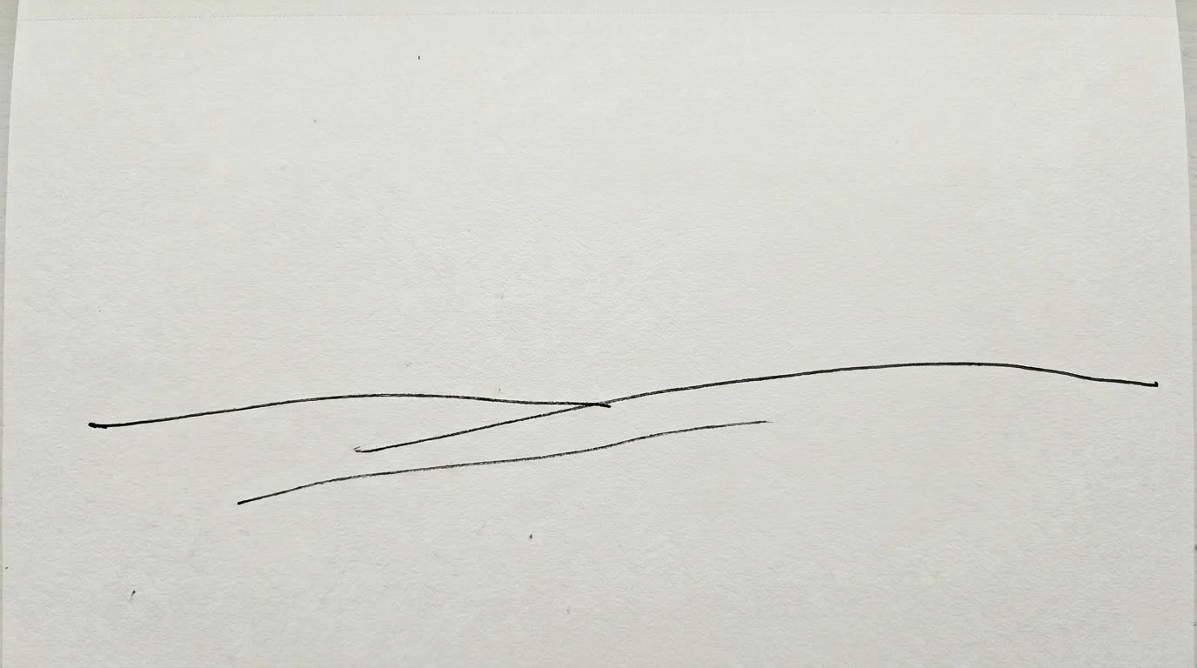
Notes:
Everyone draws roughly this. No hesitation.

Slide 5
On the field, draw a simple
house with a door and a window.
02
KEYNOMEN AVIATION

Slide 6
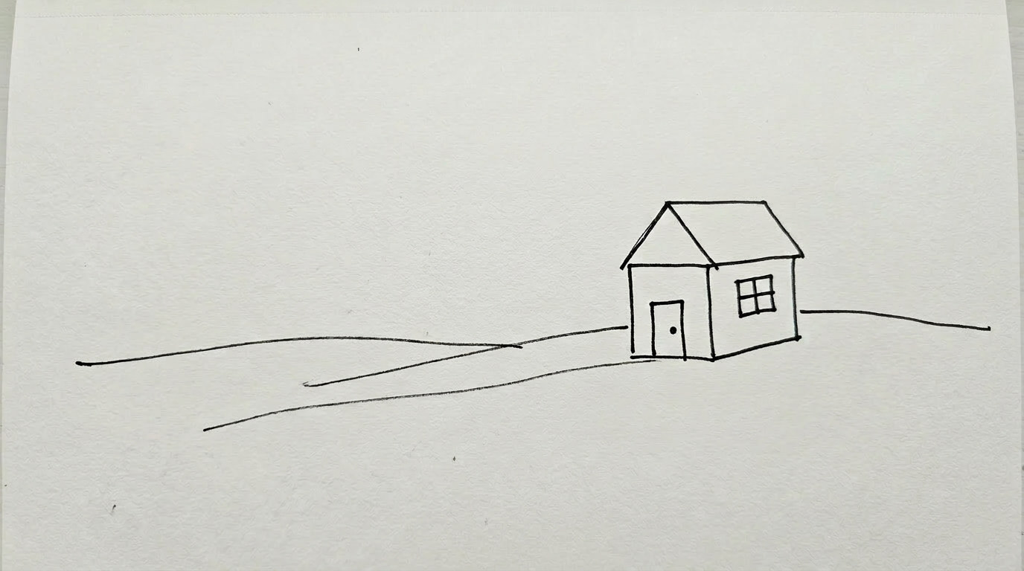
Notes:
Still no hesitation.

Slide 7
Give it a chimney, with
smoke coming out.
03
KEYNOMEN AVIATION

Slide 8
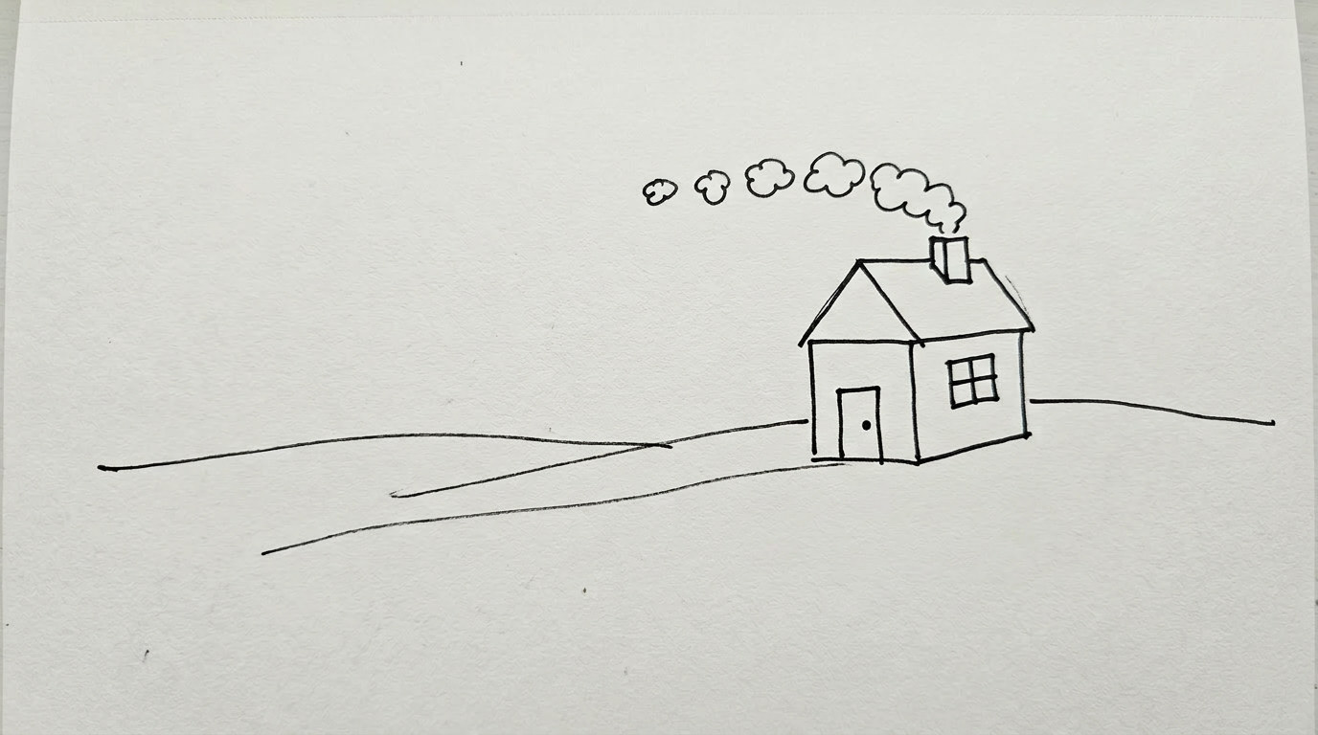
Notes:
Three for three. Everyone is with you.

Slide 9
Now put a dub in
front of the house.
04
KEYNOMEN AVIATION
Notes:
THE TURN. Stop talking. Let the silence do the work - this is the single most important pause in the presentation.

Slide 10


Stuck? Of course you are.
Notes:
The expression is the point. Everyone in the room is wearing it.

Slide 11
So let’s do what they used to teach you back in school …
“Figure out the meaning within the
context of what you’re reading.”
KEYNOMEN AVIATION

Slide 12
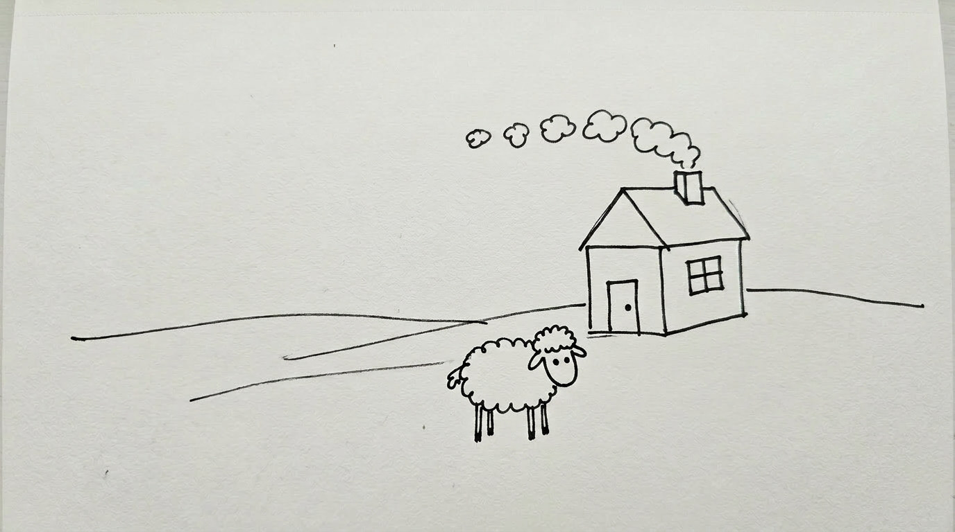
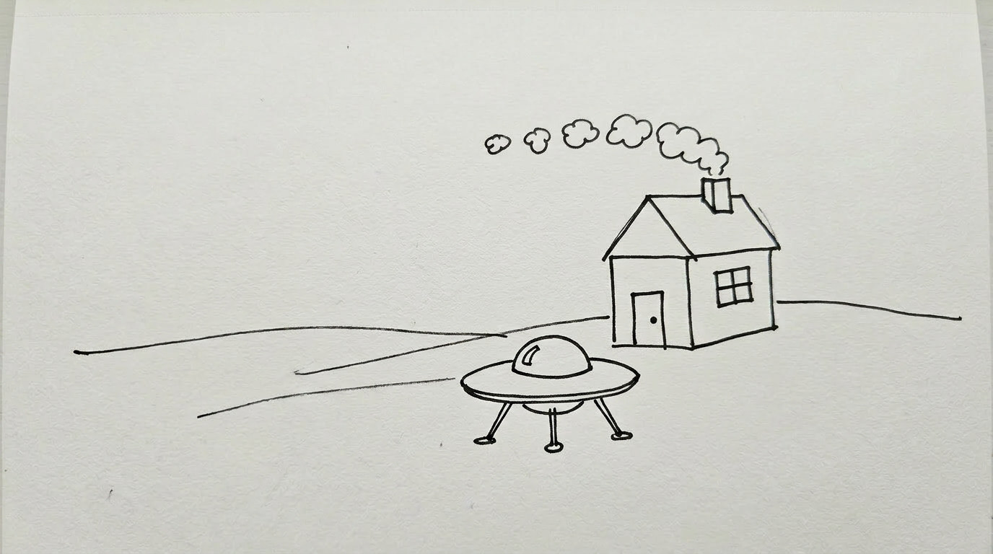
Yeah, right. You may as well say:
Just go ahead and invent a meaning.
Results vary, don’t they?
KEYNOMEN AVIATION
Notes:
The advice everyone was given, why it fails, and the proof: two real guesses, neither of them a puddle.

Slide 13
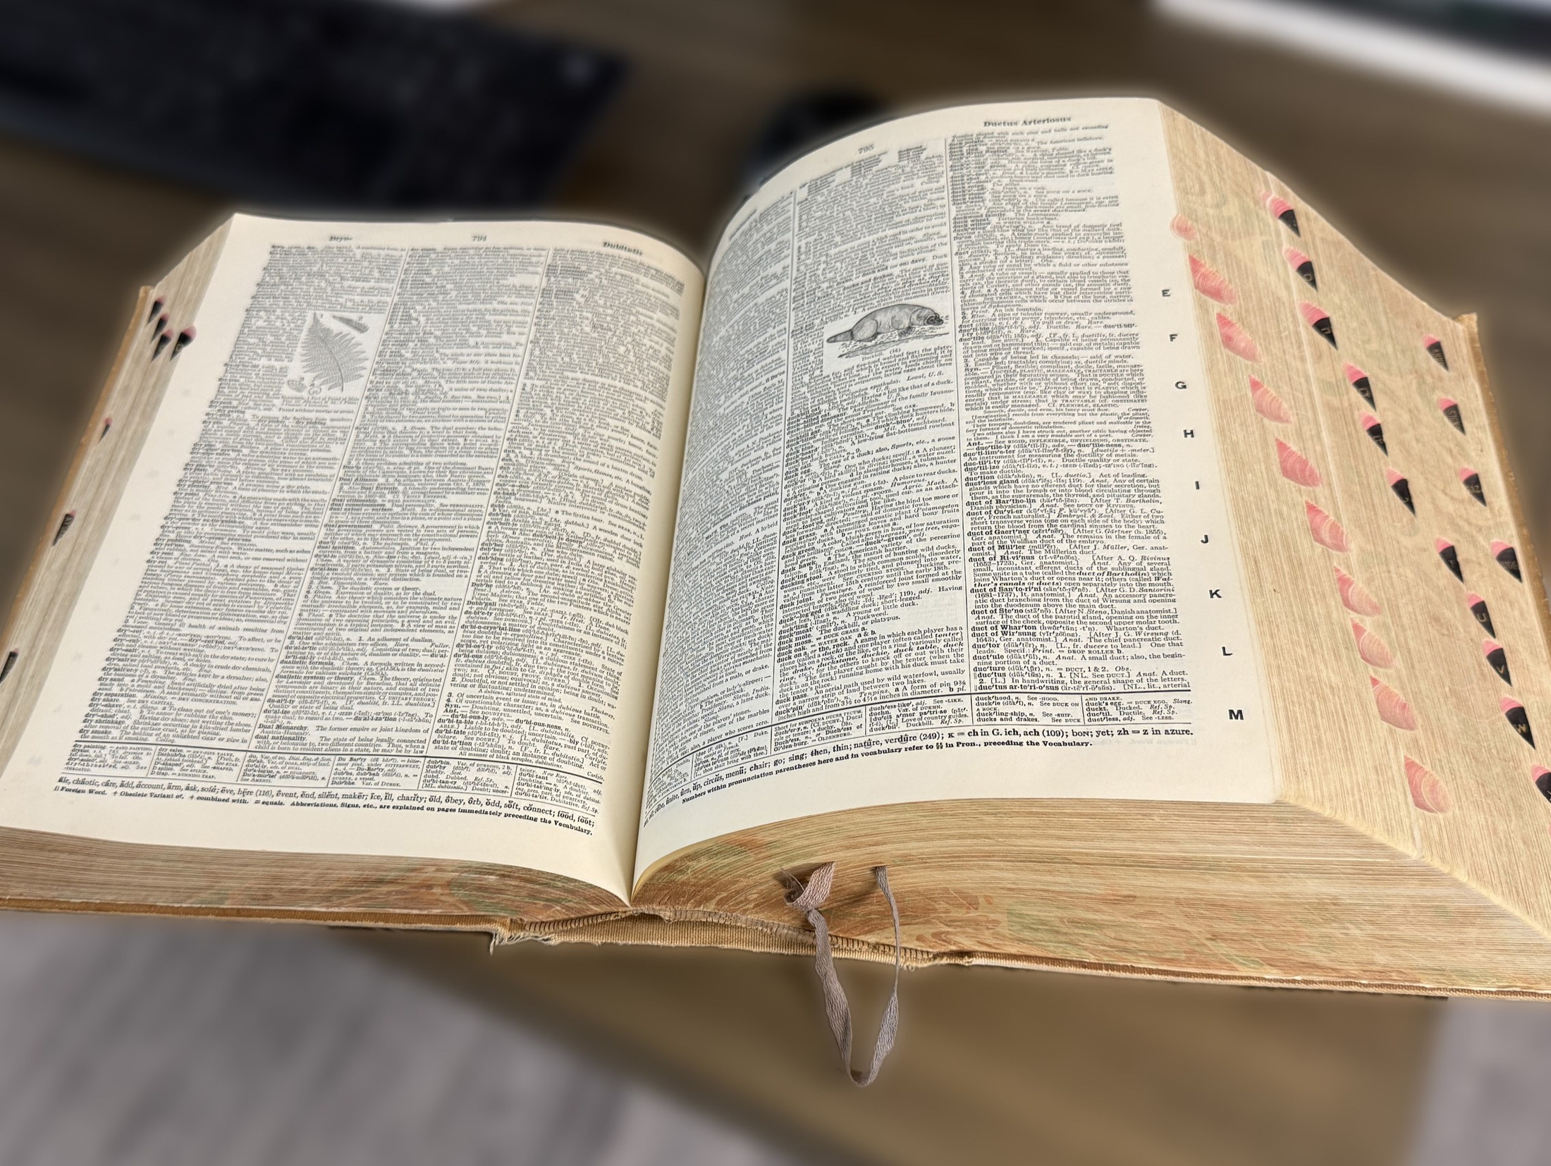
Now let’s do the one thing that actually
works - look it up in a good source.

Slide 14
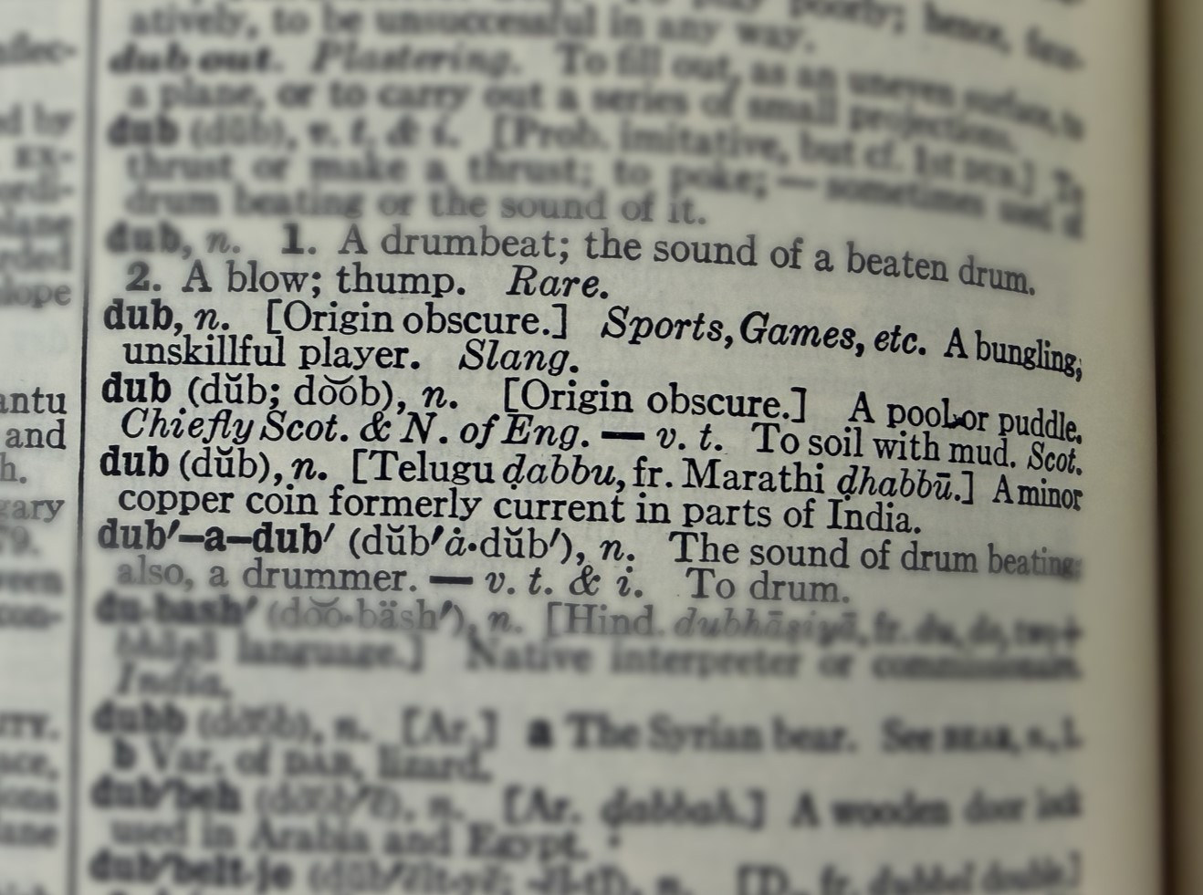
Dub: a pool or puddle.
Notes:
The entry, then the reveal. One word, one meaning, and the whole room unlocks.

Slide 15
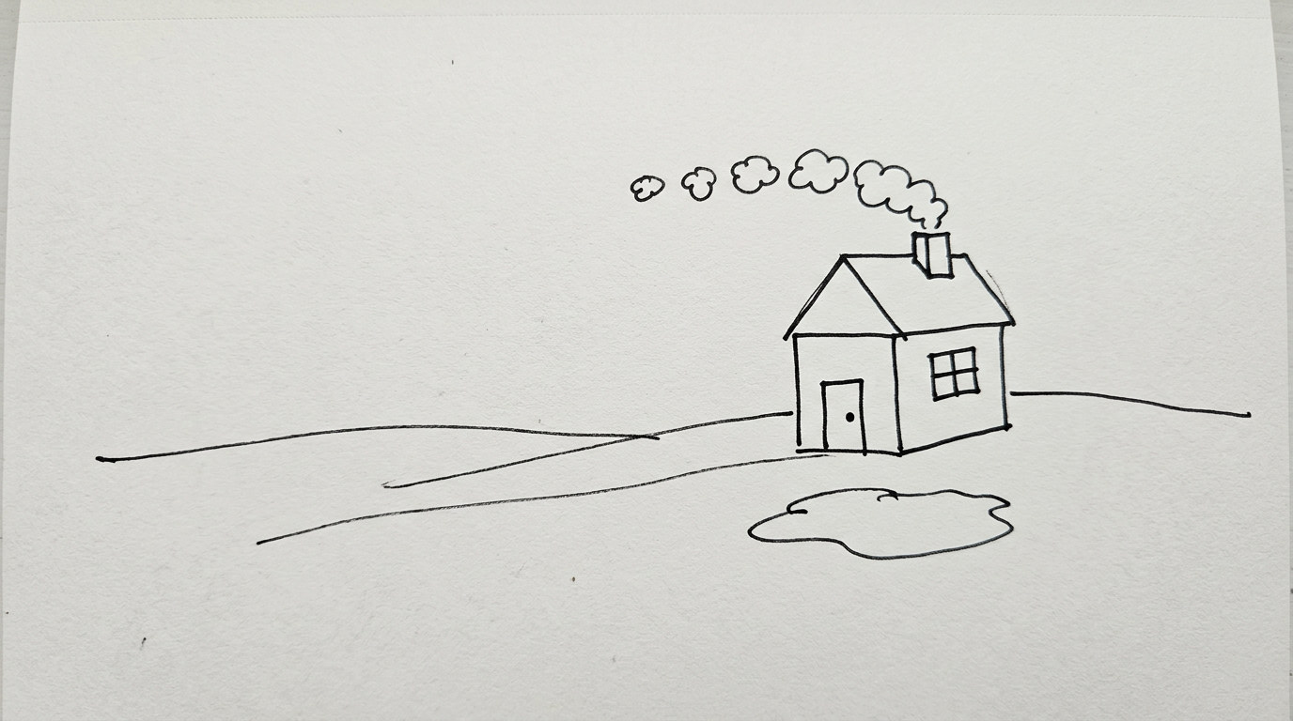
Notes:
Now everybody draws the same thing.

Slide 16
One word - understood - and you can
do what stumped you seconds ago.
KEYNOMEN AVIATION
Notes:
The payoff of the whole exercise. The stress is on DO - understanding is not academic, it is the difference between acting and freezing.

Slide 17
Now imagine having that “dub moment” a few thousand times over…
Notes:
Deliberately the same two faces from step 04. That is the joke - and the point.

Slide 18
The language of aviation has thousands of technical terms.
The jargon is huge. There are many new words to learn.
Certificate / Rating | Skills to Rate | Unique Terms | Total Terms
Private Pilot | 53 | 2,463 | 2,463
Instrument Rating | 36 | 1,794 | 4,257
Commercial Pilot | 51 | 647 | 4,904
Flight Instructor (CFI) | 76 | 967 | 5,871
Unique Terms = words that certificate adds that no earlier one carries.
KEYNOMEN AVIATION
Notes:
Live counts from the Training Tracker, taken 2026-08-07. Total Terms is a running balance down the ladder, not each certificate's own list size. For a flight school audience, the Unique Terms column is the argument: this is what a student meets for the first time.

Slide 19
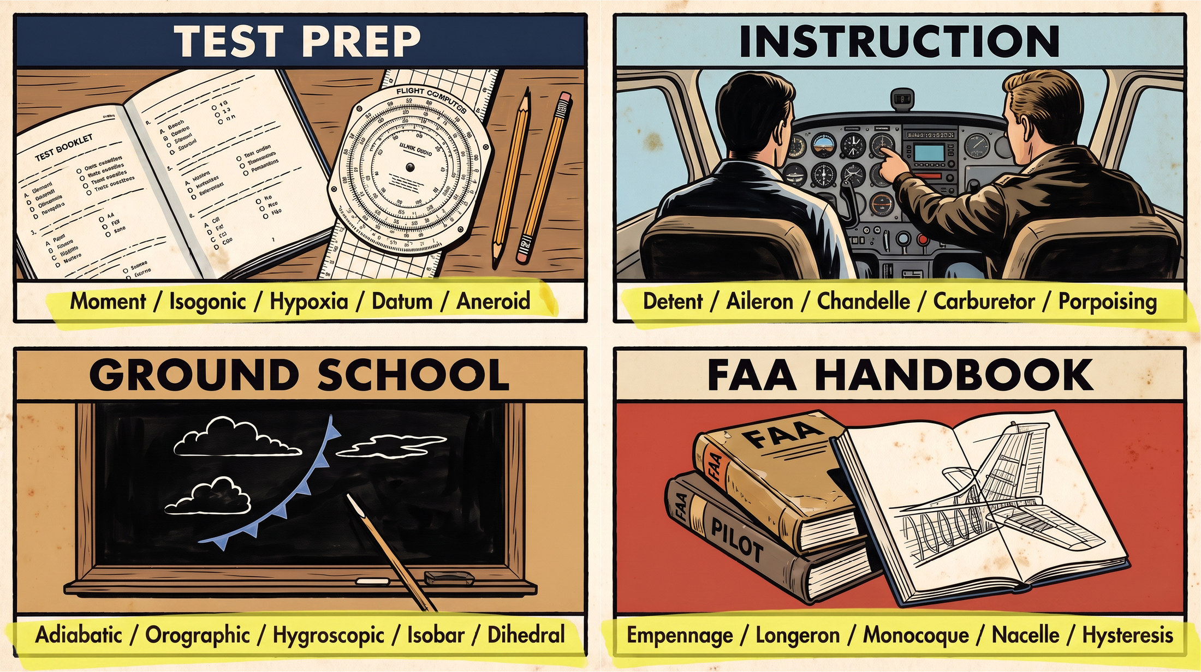
You will encounter these words
in all parts of your training.
Notes:
Test prep, instruction, ground school, the FAA handbooks - four tools they already own and pay for, all speaking the same language. Five real terms printed under each.

Slide 20
To master the language, you
have to understand the words.
KEYNOMEN AVIATION

Slide 21
JOE AND CHARLIE
Two students.
KEYNOMEN AVIATION

Slide 22


Joe - goes past words he does not understand

Slide 23

“I got bored. My mind went
blank. I kept re-reading the
same paragraph and nothing
stuck. I lost interest. I figured
I just wasn’t cut out for it.”

Slide 24


Charlie - gets words cleared up as he goes along

Slide 25

“It started to click. I felt in
control. I’d read something
once and it stayed. I leaned
in. I knew I was built for this.”

Slide 26
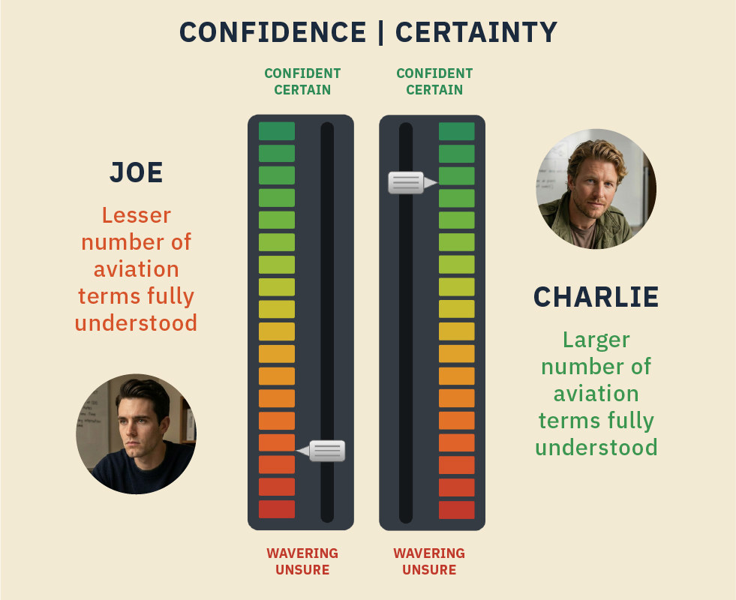
A solid grasp of the words builds certainty and confidence - each word you fully clear up moves your slider up.

Slide 27
Now imagine having a dub
moment - on short final.
THE FOUR FORCES
Every flight comes down to four forces.
Lift, weight, thrust, drag - locked in a constant tug-of-war.
Notes:
The stakes line, then the section it opens. Let the gold line sit before you move down the slide.

Slide 28
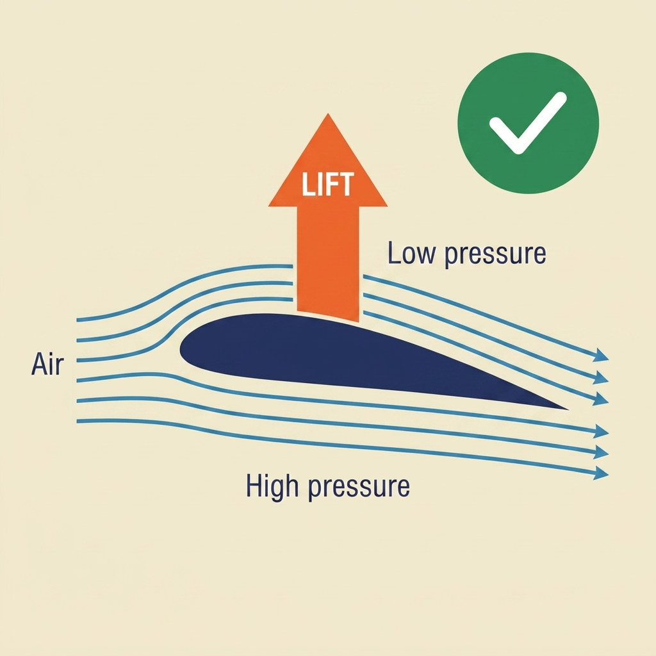
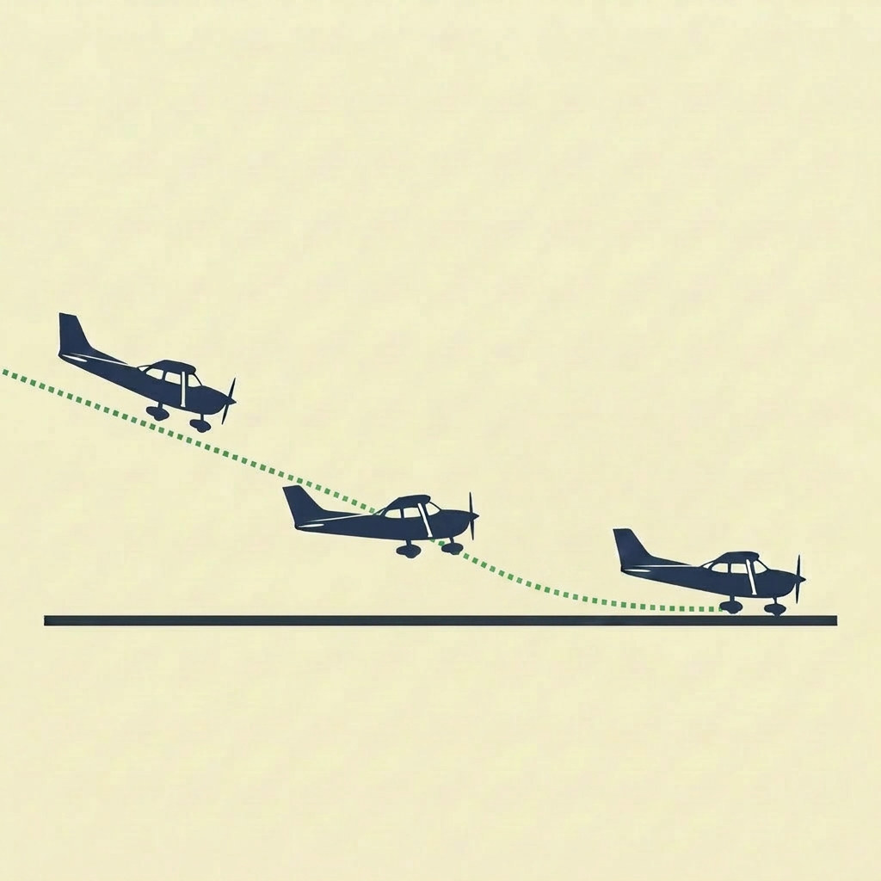
Charlie knows exactly what each one means. To him, lift is a real thing - the force that holds the airplane up - and he can feel it building and bleeding away as he flies the approach.
Charlie greases the landing.

Slide 29
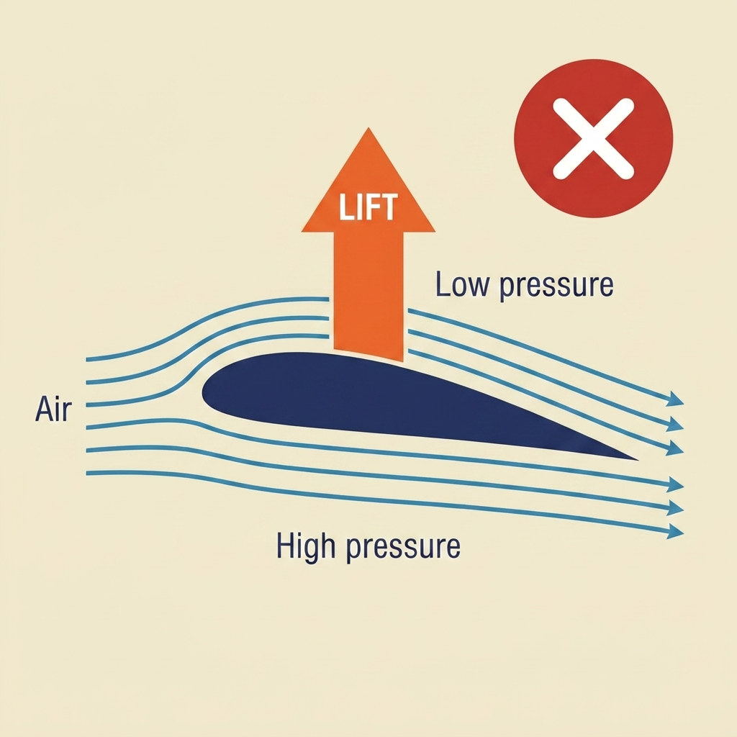
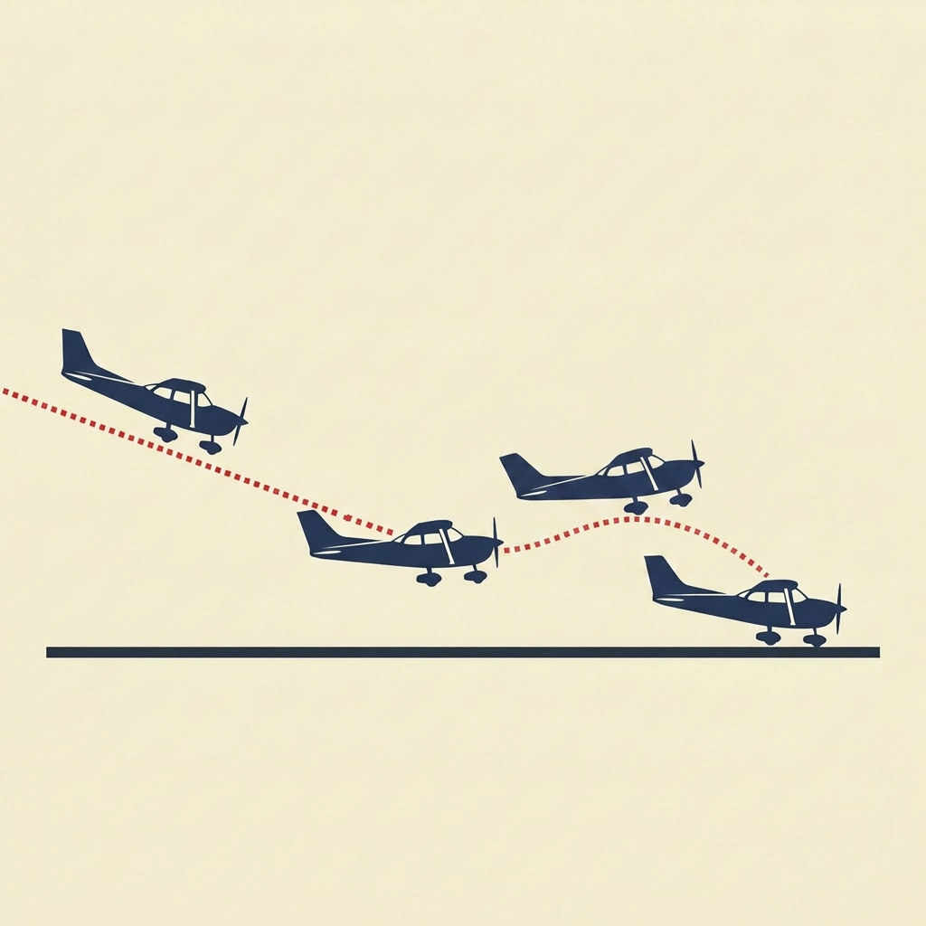
Joe is fuzzy on this. Somewhere along the way, Joe got lift tangled up with elevator (as in a building). He once heard a British fellow call it that - so in the back of his mind, “lift” is the little box that carries you straight up between floors.
Joe balloons it.

Slide 30
Same two students.
One is shaky on the meanings of the words; the other understands them clearly.
KEYNOMEN AVIATION
Notes:
Not talent. Not money. Not the instructor. The words.

Slide 31
LOOKING IT UP ISN’T ENOUGH
Just look up the words, right?
Not quite. Here’s the trap almost everyone falls into.
KEYNOMEN AVIATION

Slide 32
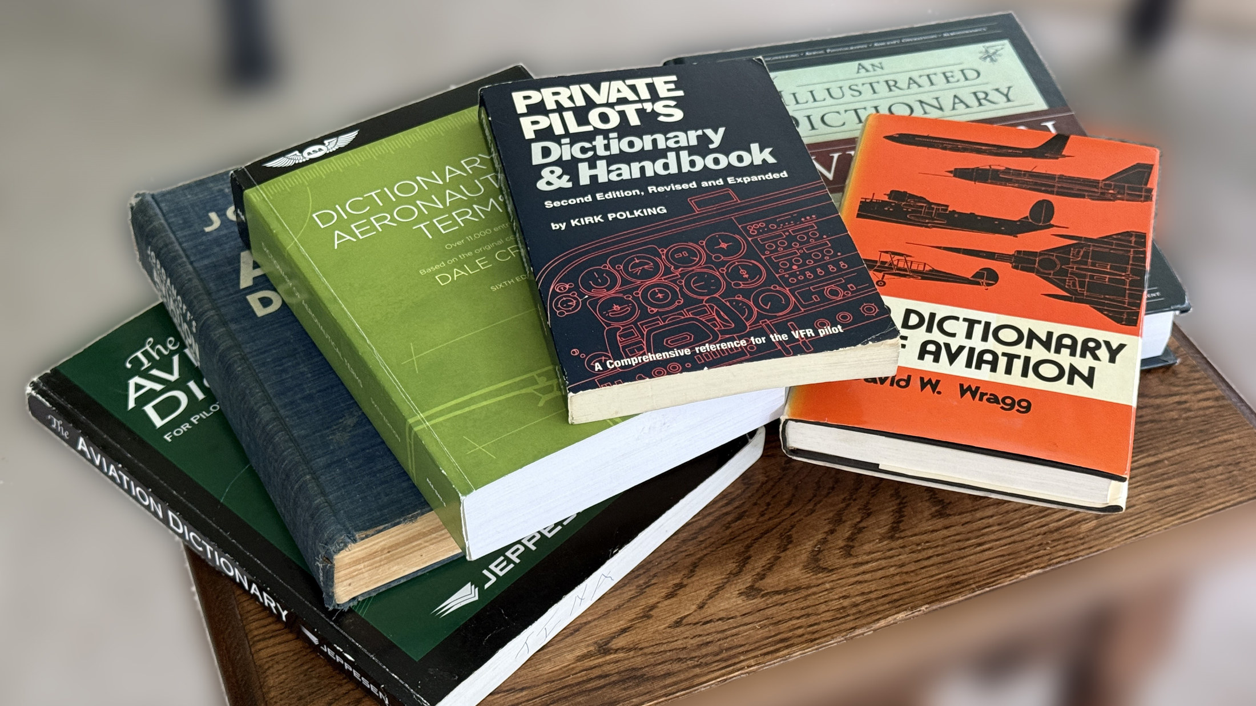
Take a real one: empennage. You hit it in your handbook, you don’t know it, so you do the right thing and look it up:

Slide 33
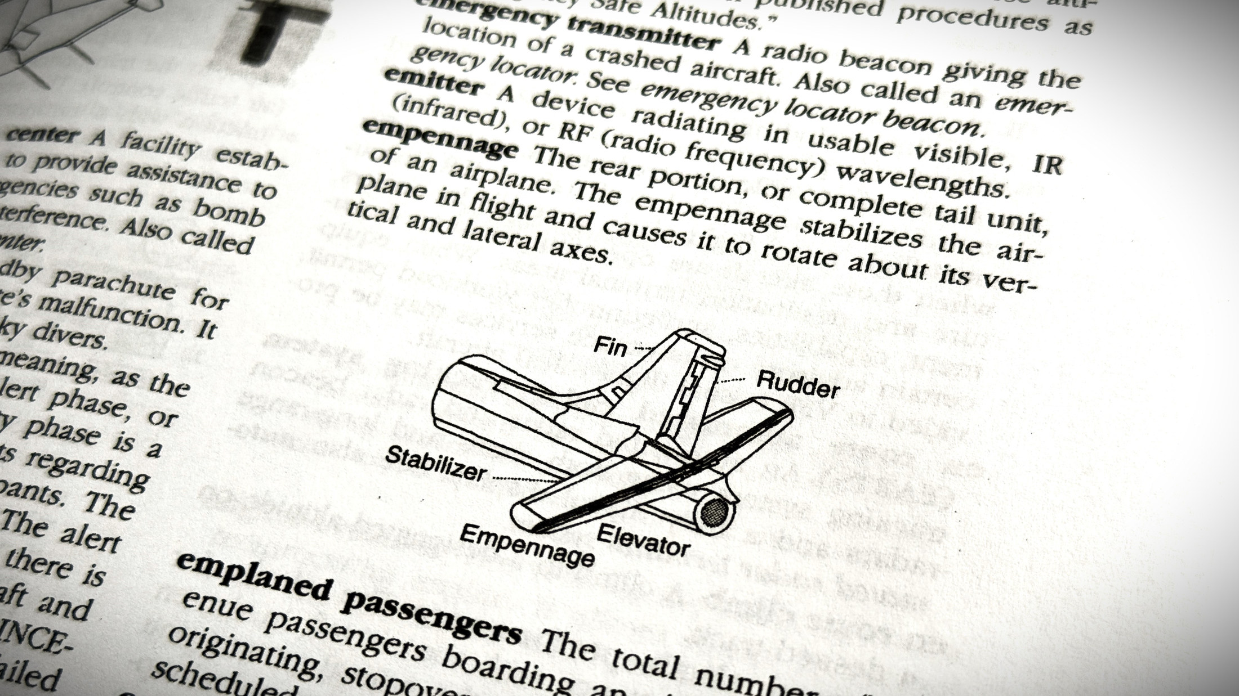
Empennage: the tail section of an airplane, consisting of the horizontal stabilizer, vertical stabilizer, elevator, and rudder.

Slide 34

Technically correct. And yet…
You’ve got a “definition” - but you don’t feel any brighter for having it.
Notes:
Correct, and useless. He is no brighter for it.

Slide 35

Here’s what was missing: where
the word actually comes from.
Empennage comes from the French empenner - “to feather an arrow.” From the Latin penna, feather. It’s the fletching - the feathers on the back of an arrow that keep it flying straight and stable.
Notes:
This is the methodology in one slide. Not a dictionary gloss - the derivation, which is what makes a word stick.

Slide 36

And just like that, it clicks. You’ll never look at a tail section the same way again - because you now have the complete meaning of the word, not the partial one.

Slide 37
DEATH BY A THOUSAND CUTS
Why so many quit.
Ask why so many student pilots quit — and you’ll hear a hundred answers.
“I ran out of money. I had a bad instructor. I burned out. I lost
confidence. The spark just died. I guess I wasn’t cut out for it.”

Slide 38
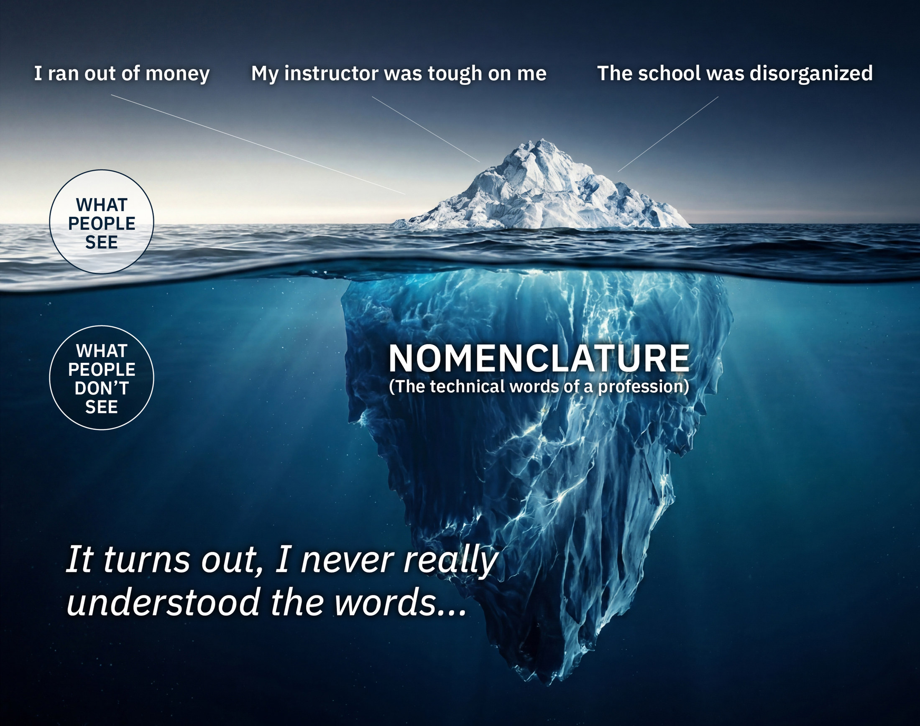
It all sounds
true — but
those are
symptoms.
There is a
root cause.
Notes:
Above the waterline, the reasons people give. Below it, the mass that actually sank the thing: NOMENCLATURE - the technical words of the profession.

Slide 39
Every word that slips past you half-understood leaves a tiny dull spot. A flicker of “I’m not quite sure” you don’t even register. They accumulate. A hundred of them, a thousand of them, and you’re foggy, tense, a step behind - with no idea why. A slow erosion you can’t trace to its source.
Notes:
Joe worn down by the material - the picture of the slow erosion the paragraph describes.

Slide 40


TWO PATHS
Which path is yours?
Joe - another name in the 80%.
Charlie - living the dream.

Slide 41
The Joe path | The Charlie path
“I’ll figure it out as I go.” | Walks in already understanding the words.
Never quite certain of anything. | Arrives at every lesson prepared and sure.
A low hum of anxiety that never lets up. | Calm and in control, lesson after lesson.
Frustrated, discouraged, the spark fading. | Confident, building momentum, enjoying it.
Still no solo at 30+ hours. | First solo at 12 hours.
Death by a thousand cuts. | Each chapter cleared before it’s flown.
Drops out. Thousands of dollars gone. | Completes as planned - on budget.
Just another name in the 80%. | Lives the dream.
KEYNOMEN AVIATION
Notes:
Two students, same course. The only variable is what they did with the words they didn't know.

Slide 42
START FREE
Don’t wait to see what happens.
The fog never announces itself. By the time “this isn’t really working for me” shows up, the dull spots have already stacked up. The time to handle the words is before they cost you - before the next chapter, the next lesson, the next hour of instruction.
So start now, while it’s easy.
KEYNOMEN AVIATION

Slide 43
Create a free account. No credit card, nothing to cancel. You get the full Keynomen treatment on your first 100 terms - every section, every certificate you earn. And when you move up to Pro, it all comes with you: your cleared words, your points, your certificates carry straight over.
You’ll feel the difference inside the first chapter. The language stops fighting you, and flying starts making sense.
KEYNOMEN AVIATION

Slide 44
Start free at
keynomen.com
Start Free →
No card. No catch. Just your first 100 words - fully handled.

Slide 45
ONE YEAR LATER
And Joe?
Joe didn’t wash out.
KEYNOMEN AVIATION

Slide 46

He went back to the words that kept slipping past him - one at a time. The fog lifted. The chapters got lighter. The flying followed. Today, Joe and Charlie wear the same uniform.
Turns out Joe had what it takes all along.
He was just missing the words.
Notes:
The close of the story. Land on the last line before you turn to what the product actually does.

Slide 47
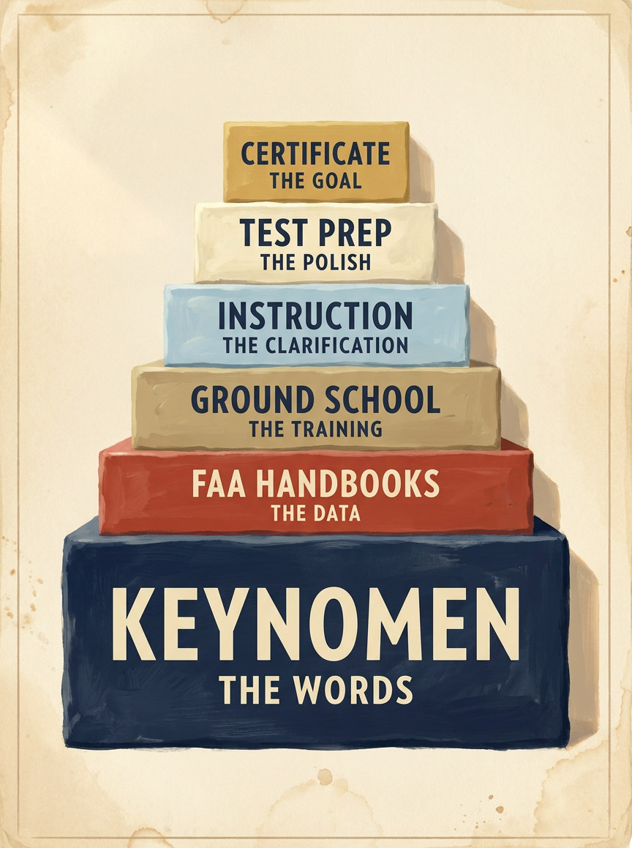
WHERE IT FITS
Here’s where
Keynomen fits in.
Keynomen sits underneath everything else you’re using - ground school, online school, private instruction, flash cards, test prep. You learn the language of aviation in an easy, relaxed way. Simply work your way through your list - marking each term “Log as Cleared” as you go along.
KEYNOMEN AVIATION
Notes:
The stack, bottom to top: Keynomen (the words), FAA Handbooks (the data), Ground School (the training), Instruction (the clarification), Test Prep (the polish), Certificate (the goal). For school owners: this is the slide that says Keynomen does not compete with what they sell - it makes it land.

Slide 48
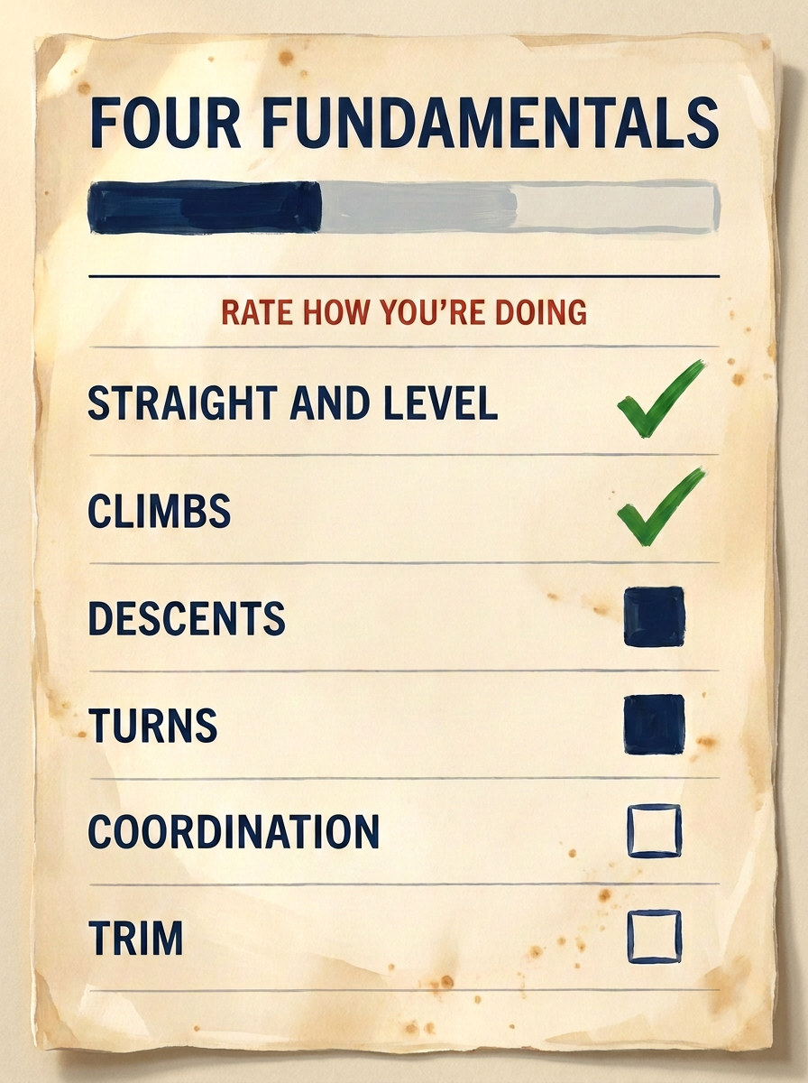
TRACK YOUR SKILLS
Know where you stand.
Now you can keep track of your progress. It’s your confidence in your skills that drives you through the training, so here’s a tool that shows you where you stand - your strong areas, and the ones that need more attention.
KEYNOMEN AVIATION
Notes:
Version 1 of Keynomen was live when Daniel read Jamie Beckett's article "The Most Important Documents in Aviation" in General Aviation News - a CFI since 1991 arguing that no one should begin flight training without a syllabus, and that for owners, instructors and students alike the syllabus can and should be your best friend. That article is what inspired this version. Worth naming out loud to a flight-school audience.

Slide 49
KEYNOMEN
AVIATION
Mastering the written language of aviation
KEYNOMEN.COM

